Slide 1
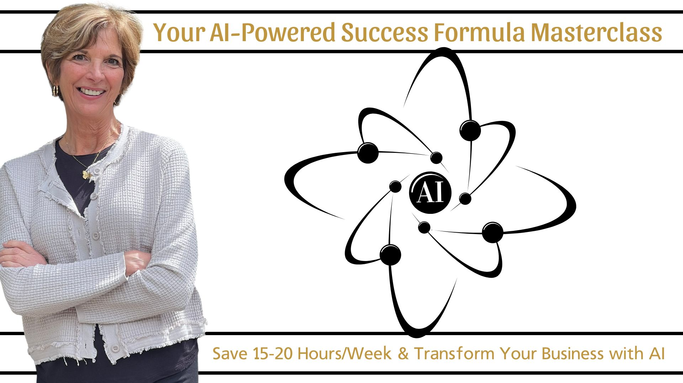

Slide 2


Slide 3
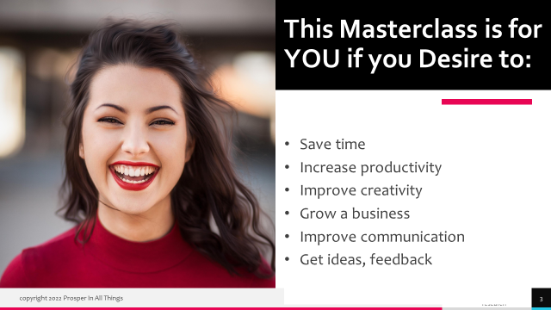

Slide 4
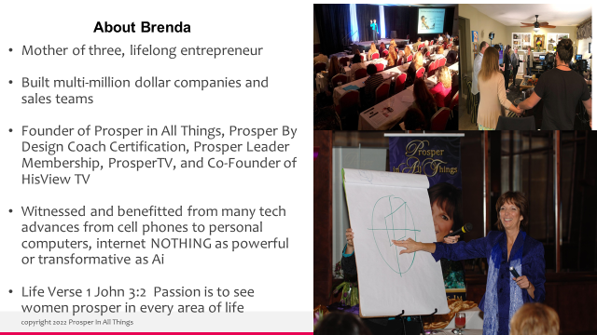

Slide 5

Why Artificial
Intelligence?
Creativity
Skills/Knowledge
Efficiency/Time
Business Growth

Slide 6

ChatGPT 4o

Slide 7
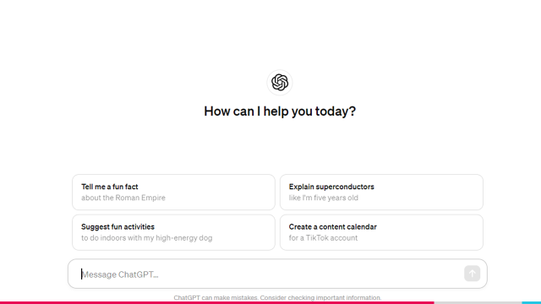
It’s all in the prompt!

Slide 8
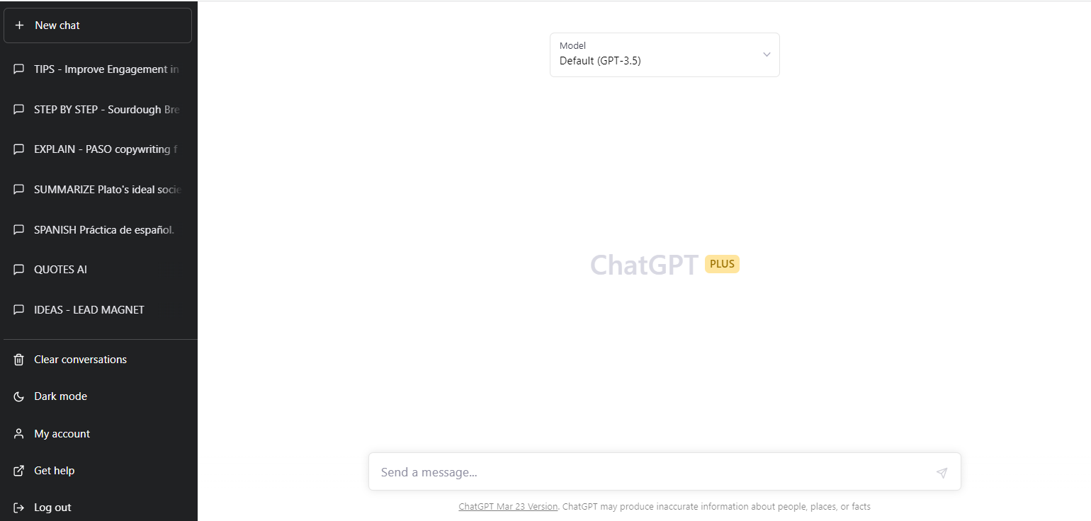
Version
History

Slide 9
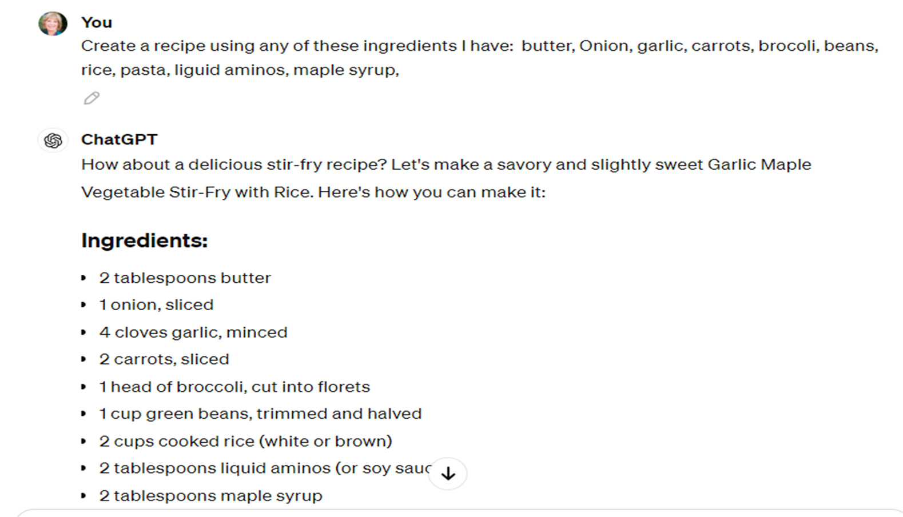
CREATIVITY: E.G. RECIPES

Slide 10
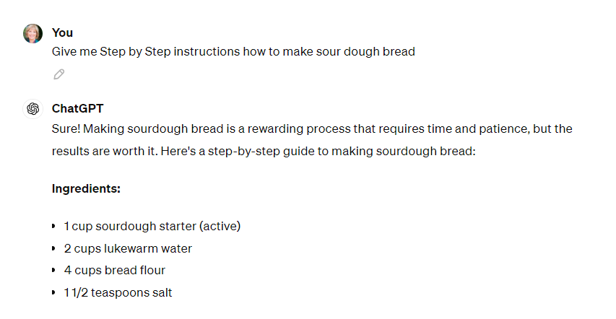
PRACTICAL: STEP BY STEP

Slide 11
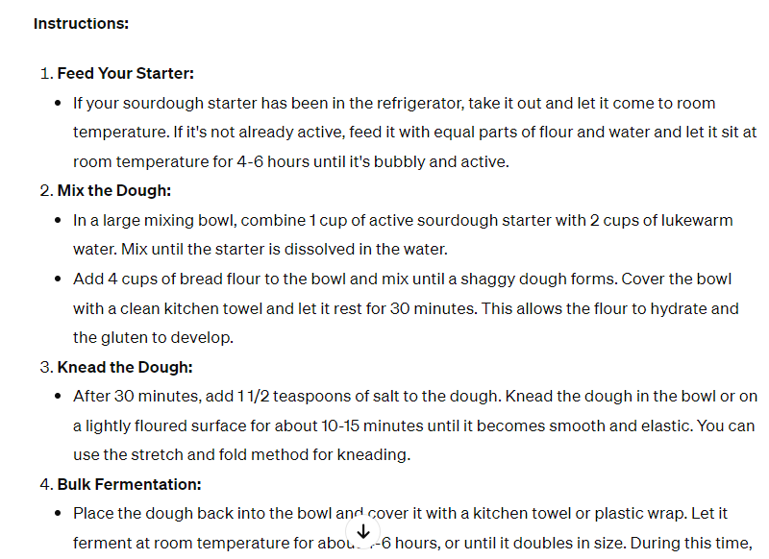

Slide 12
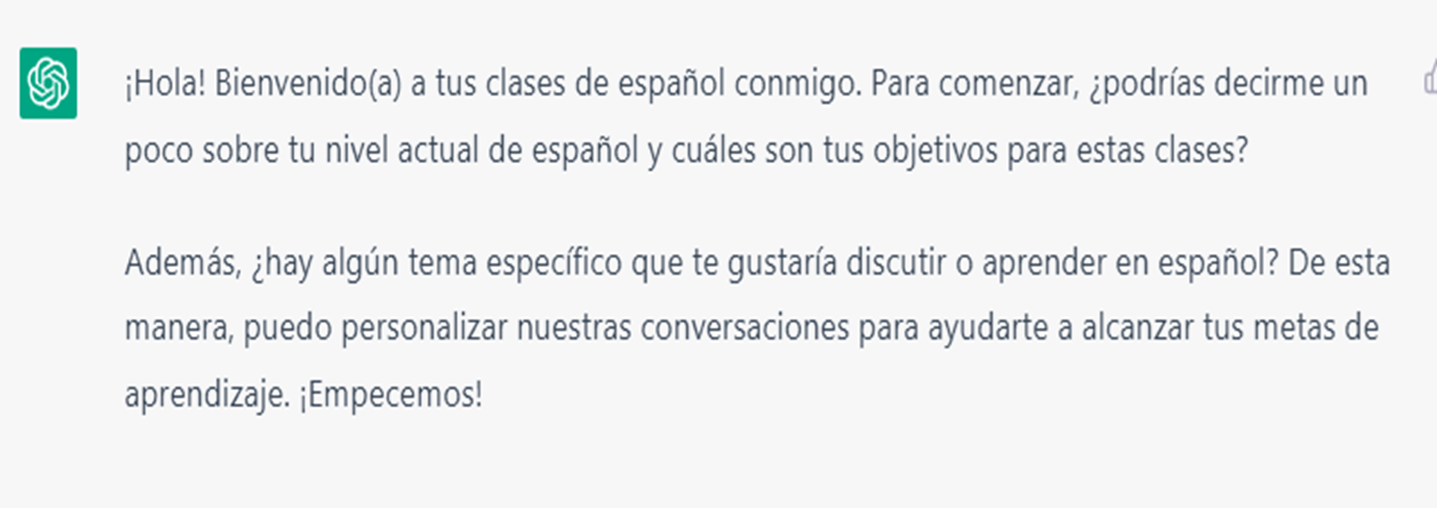
LEARN SOMETHING NEW: LANGUAGE
“You are my Spanish teacher Pedro from now on I want you to help me practice Spanish by testing my current level and then having realistic conversations with me. Correct me when I answer incorrectly and teach me new vocabulary and useful sentences. Ok Pedro I'm ready lets get started”

Slide 13


PROMPT: BRAINSTORM IDEAS
“Give me (#) (ideas, suggestions, topics, titles) for ( ______)
TIP - Give as many details as possible, what you do, who it is for, etc.
STEP TWO:
Prompts
“This is my coaching program headline and sub-headline on my website "Restore Your Health & Peace of Mind After Medical Trauma Wholistic Coaching For Christian Women " Give me 5 suggestions for a great lead magnet freebie”
REAL EXAMPLE

Slide 14
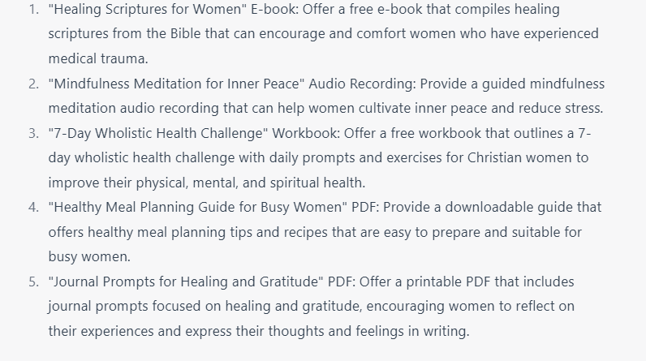
STEP TWO:
Prompts

Slide 15
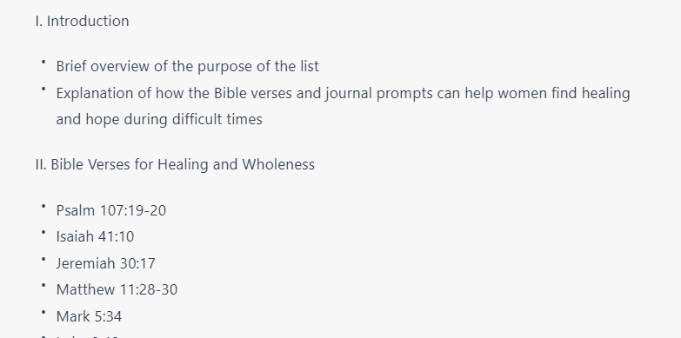

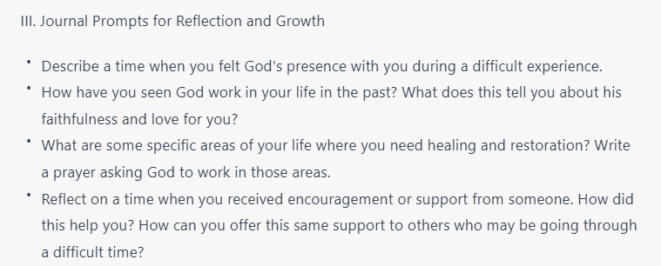
TIP - Expand Upon Previous Answer
“Create an Outline for #1 above”
STEP TWO:
Prompts

Slide 16
AI for
Marketing!
Content
Social Media
Advertising
Strategy

Slide 17

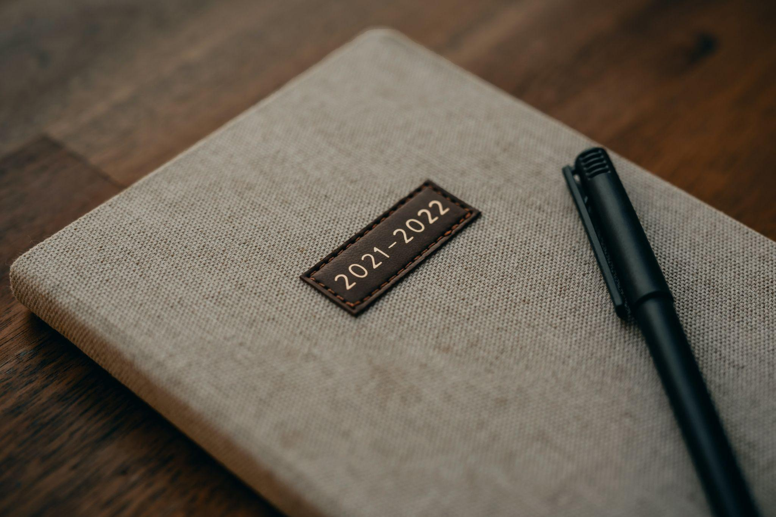

Things ChatGPT CAN do
Write – Social media posts, subject lines, emails, YouTube descriptions, outlines, introductions, marketing content, blog, reviews, ads, brainstorm

Slide 18
What I Do

Slide 19
Social Media

Slide 20
Give Clear Prompt
E.g. “Write (type of post) for (audience) that is (tone) hook, include (story, personalize) with the CTA”
Write a LinkedIn post for female coaches that is engaging and punchy with short sentences and paragraphs. Open with a hook. Include my story (describe). The CTA is (subscribe, register, etc.)

Slide 21
TIP
Stay in same thread

Slide 22
TOOL
Authored Up

Slide 23
Adobe Firefly

Slide 24
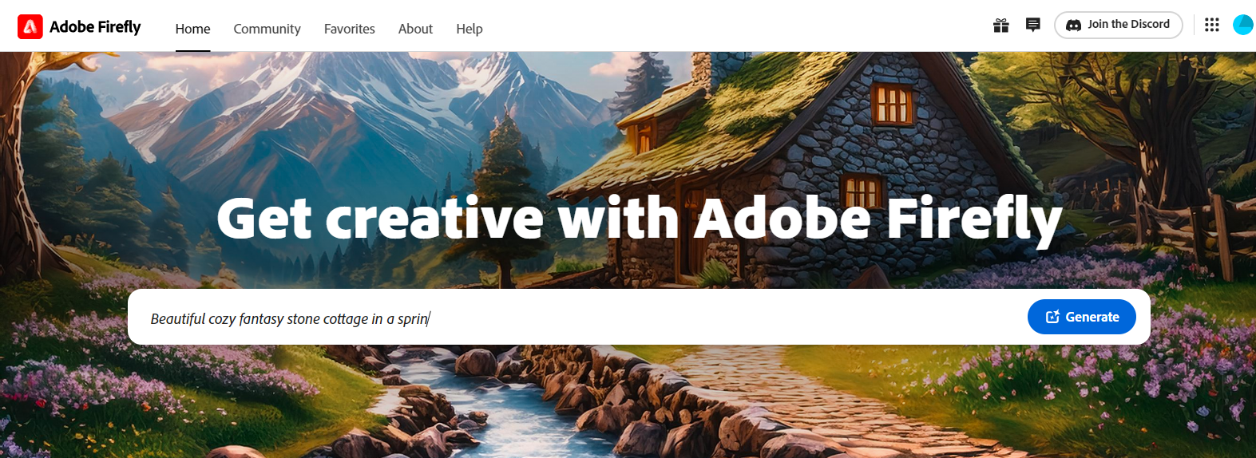
TEXT TO IMAGE

Slide 25
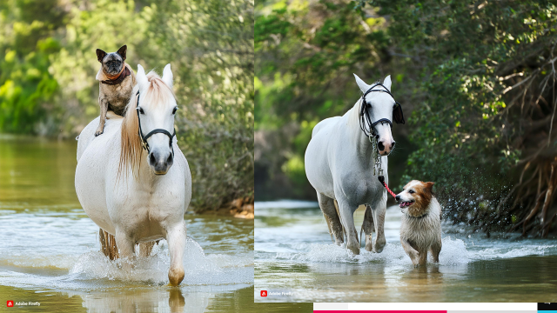

Slide 26
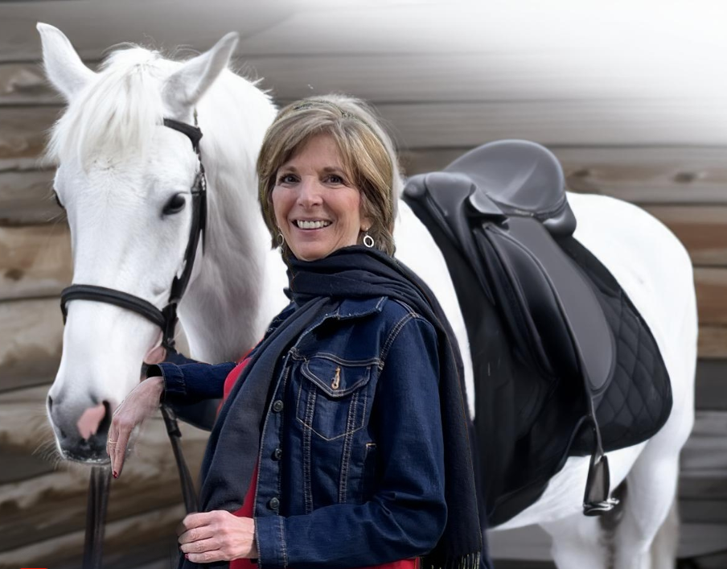

Slide 27

Creative
Writing
stories,
poems,
songs,
scripts,
titles,
ads

Slide 28
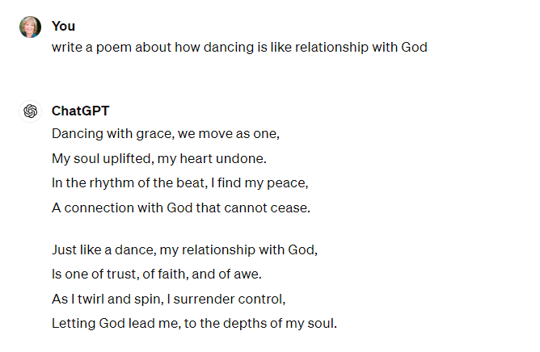

Slide 29
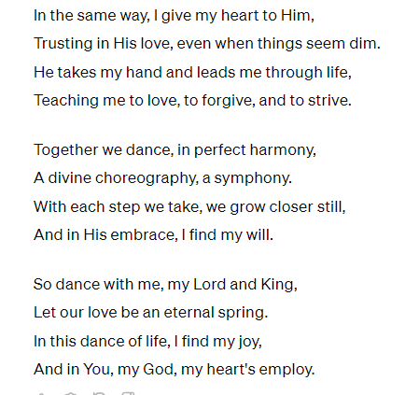

Slide 30
Content
Marketing

Slide 31
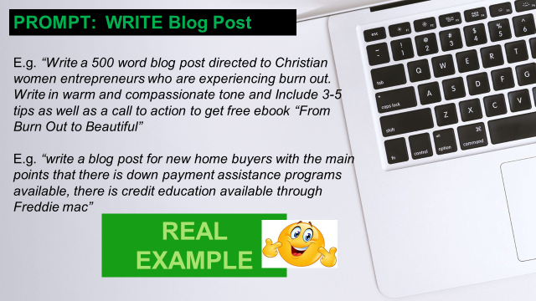

Slide 32

Social
Media

Slide 33
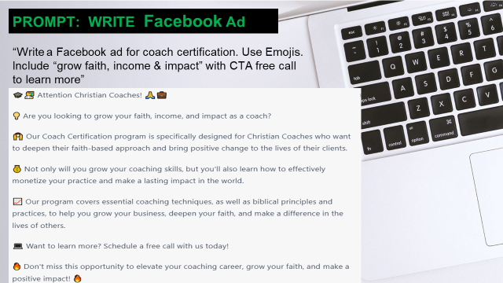

Slide 34
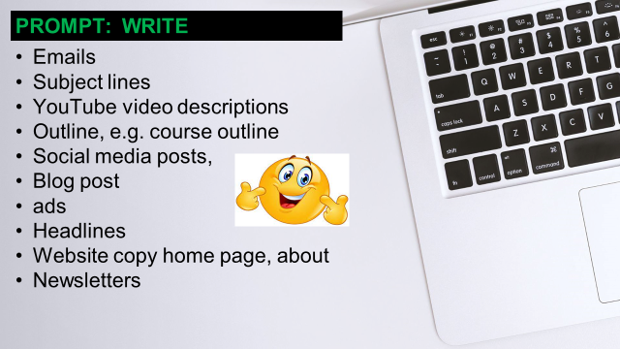

Slide 35
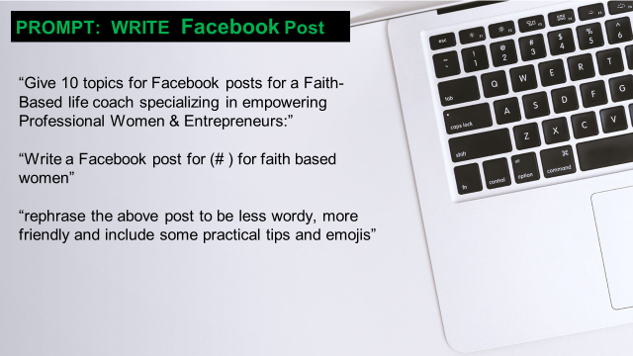

Slide 36
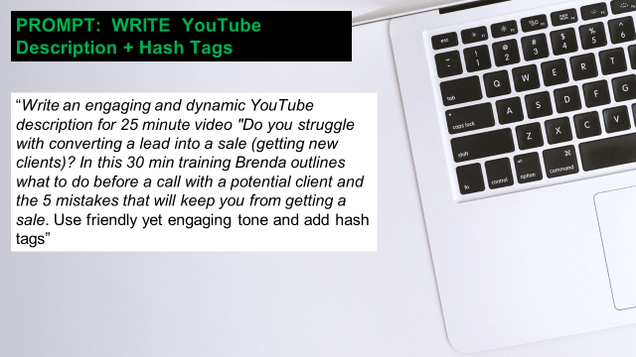

Slide 37


Videos

Slide 38
Opus Clips

Slide 39
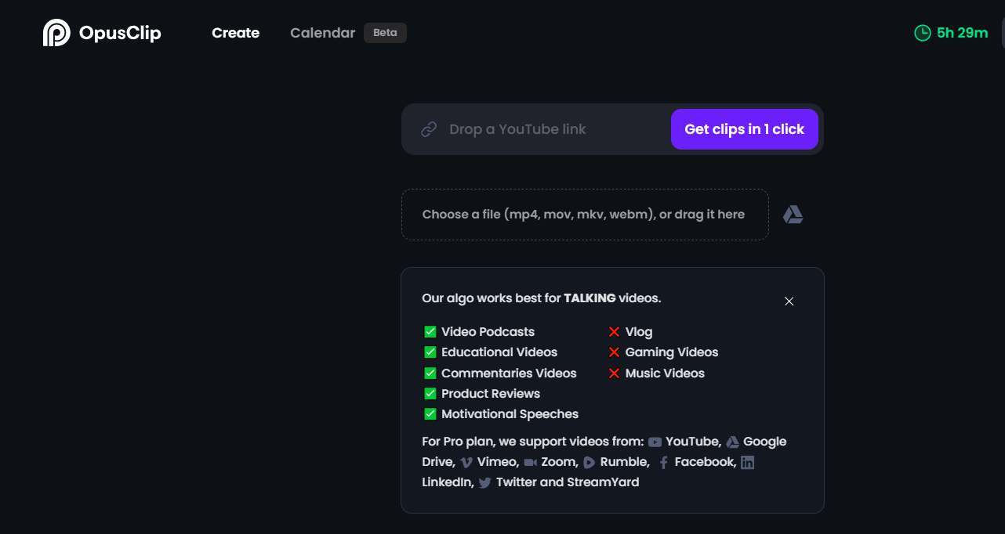

Slide 40
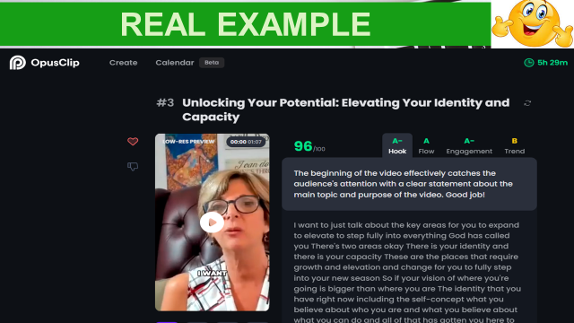

Slide 41
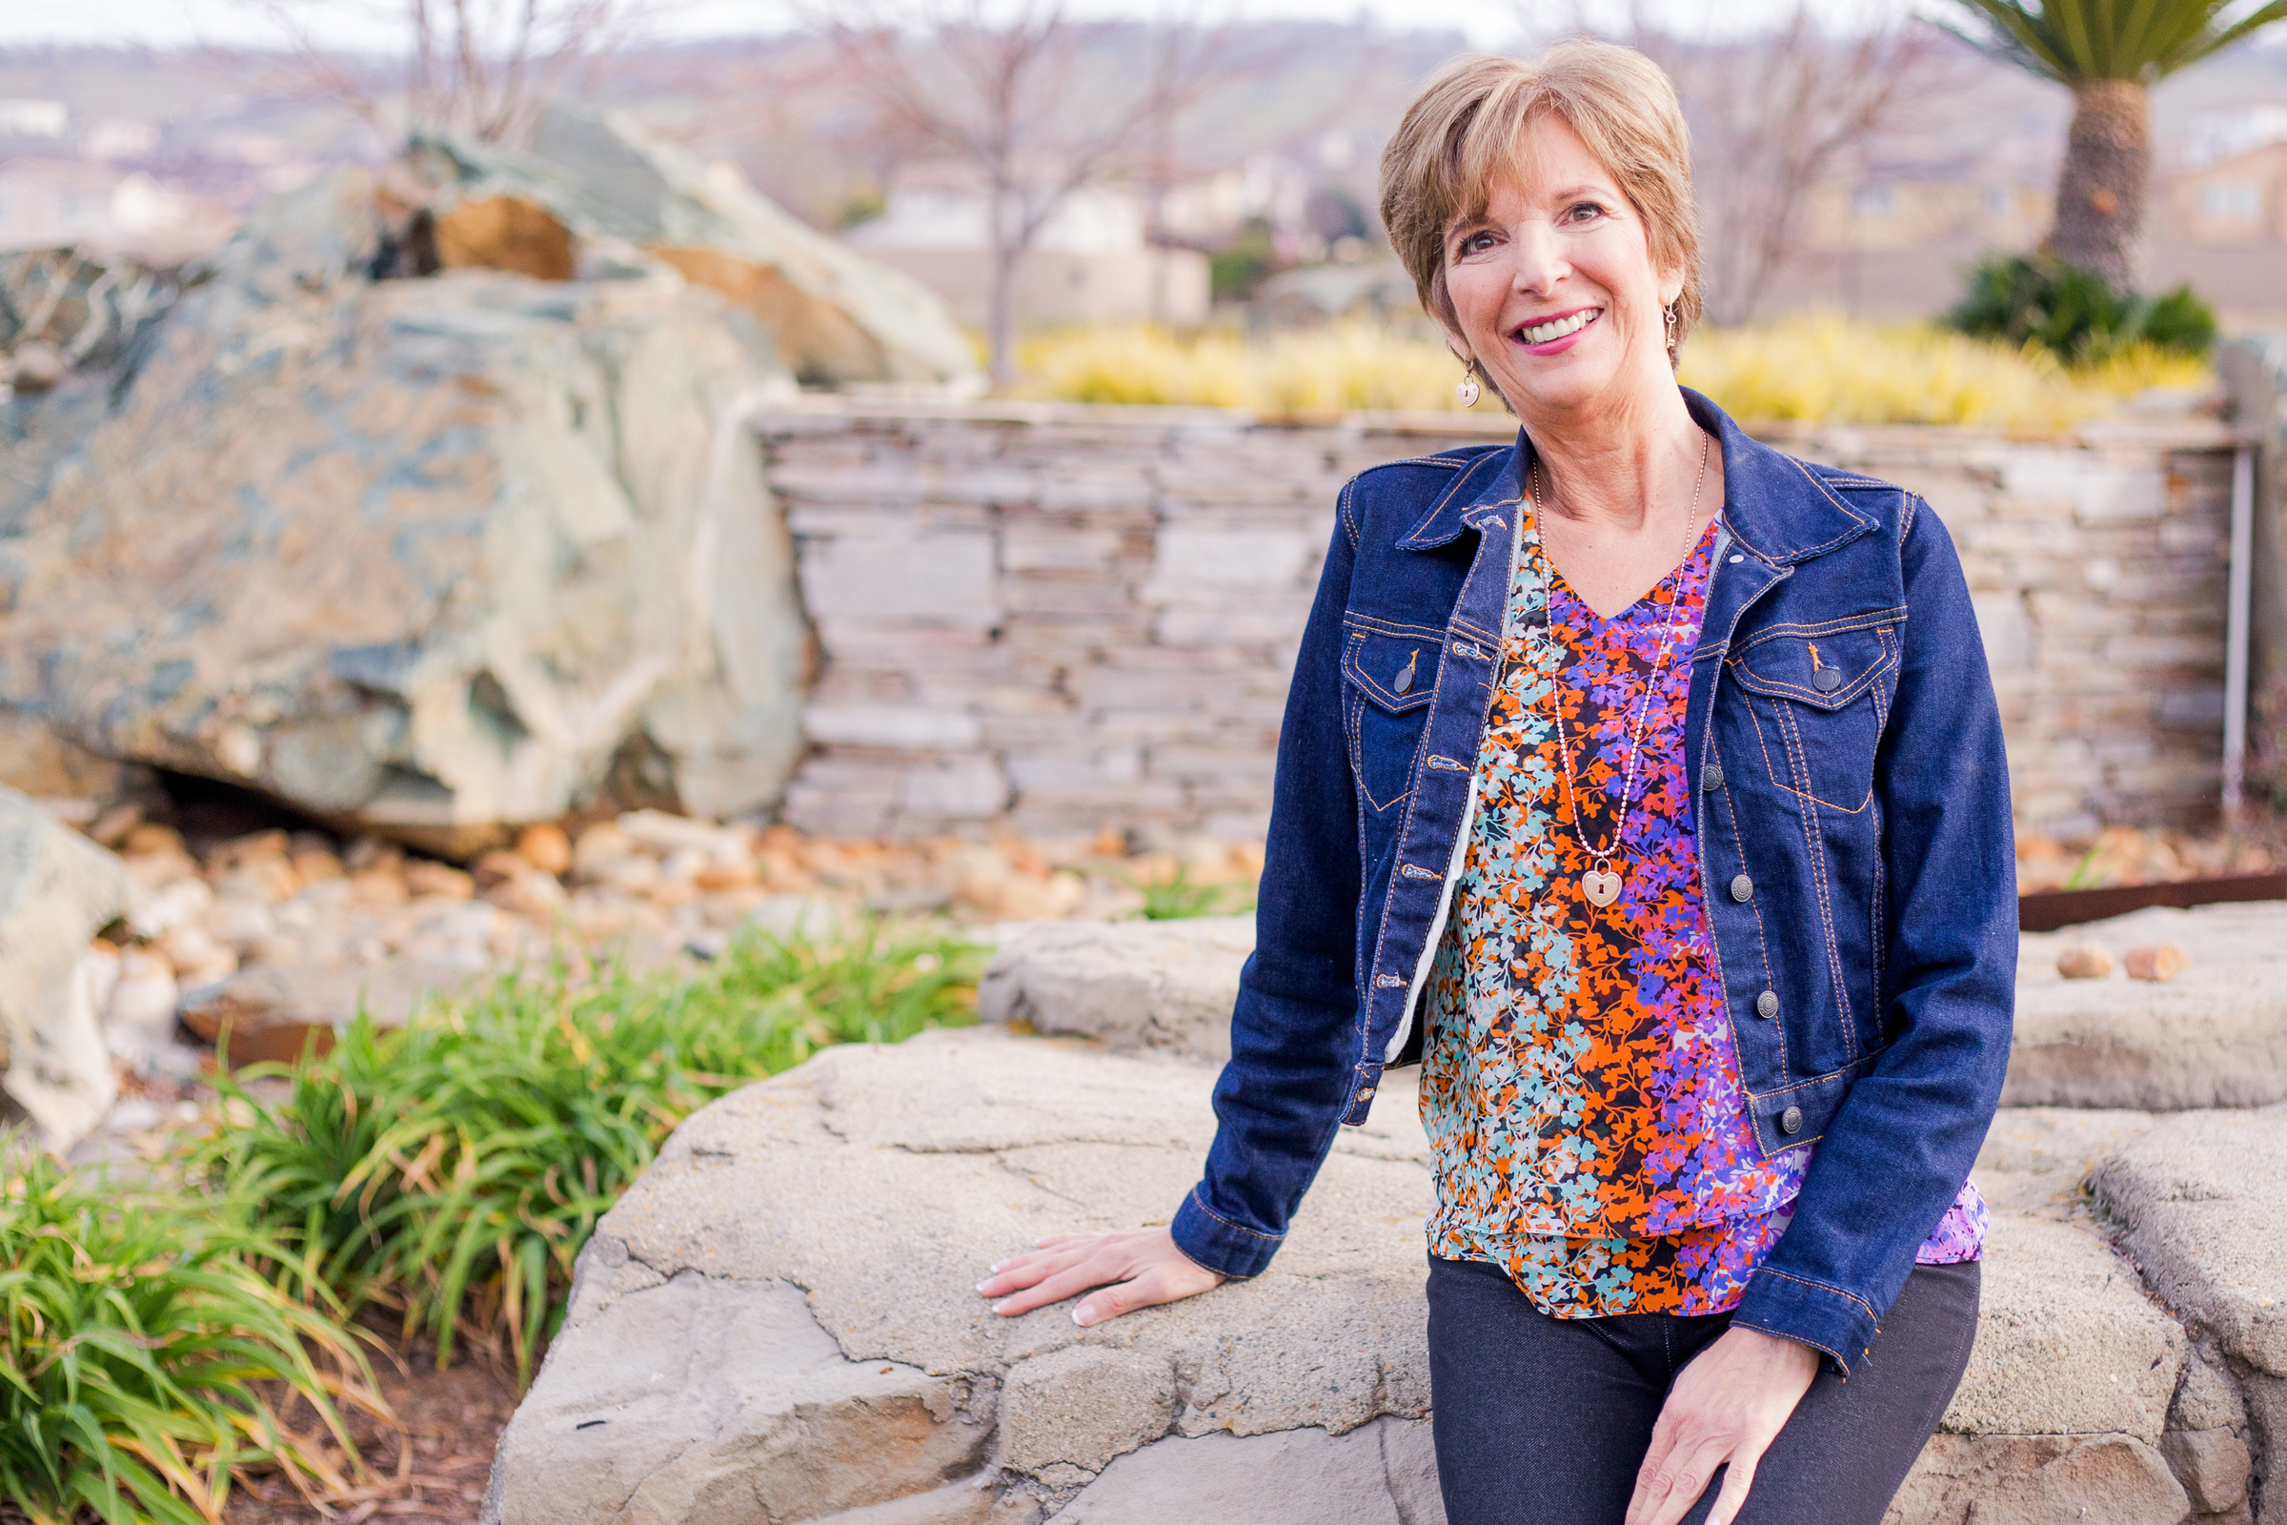
Thank YOU!
BrendaByers.com

Slide 42
Unlock the full potential of your business and achieve your goals faster with AI-powered coaching.
If you're looking to implement AI into your business but feel overwhelmed or unsure where to start, Ai Powered Success coaching program will guide you step by step to get clarity on your vision, improve productivity, and communicate more effectively with prospects & customers to grow your income and impact.
You will…
Gain clarity on your vision, niche, offerings, marketing & messaging
Improve productivity and get more of the right things done faster
Save time (15+ hours a week) so you can have more time to do what you love
Confidently attract new clients with improved marketing and messaging
Grow your income and your impact by confidently attracting new clients
Communicate more effectively and confidently with prospects and customers

Slide 43

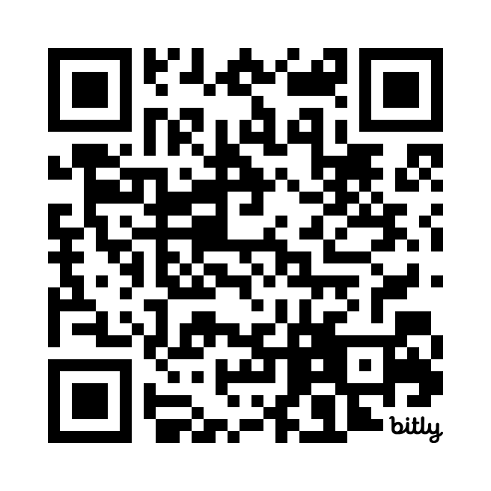

Schedule a Call
  Get Started
  Get Clear
  Get Going
https://bit.ly/AiCall

