Slide 1
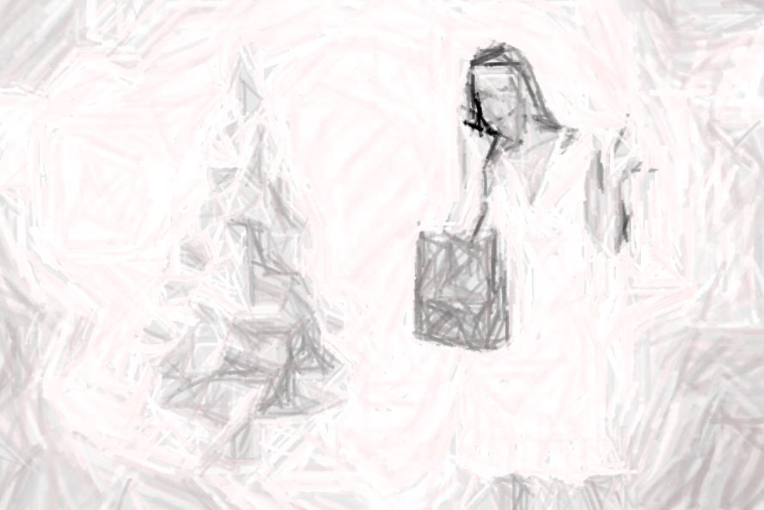
The Plan
The art of ebb and flow

Slide 2
How to Plan
Identify Number of Rooms
  Create Basic Flow Pattern = Mapping
Identify # of Colors
  Label Each Room with # Colors Based on Flow
Identify Density of Design Scale
  Label Each Room with Density # Based on Flow
Identify Each Room with Formality Scale
  Label Each Room with Formality # Based on Flow

Slide 3
Simple
Name/Number
Colors/Accents
Type/Style
……….hold on…………..don’t worry……

Slide 4
# Rooms
Work in 3-5-7 room increments if large scale home
Eyes need to register a story or engage a space
Think department stores and their “floors” – only so many

Slide 5
Map Flow Patterns
Position all possible traffic patterns
Pick the most important
Create the Story Line from important for this season
Mapping “tells a story” = way eyes register
Decorating = important, can only process so much

Slide 6
Mapping #: Transition & Eyes Land
Each room get’s a M#
1 = typically front entry
2 = next space (can be an extended hallway)
And so on….
Major elements like stairs get mapping #’s – where your eyes land in succession

Slide 7
# Colors Based on # Rooms
2 Colors + Accent
3 Colors + Accent
5 Colors + 2 Accents
7-10 Colors + 3–5 Accents

Slide 8
Color vs Accent
Color is typically a solid or metallic
Accent can be a pattern or theme see types:
  Herringbone, polka dot, shimmer
  Tartan or Plaid
  Snow
  Nutcrackers
  Nativity or Menorah

Slide 9
Accent vs Color Types
Raw/natural
Woodland
Tartan/plaid
Bling
Metal/Industrial
Nationalities
Weather related
Pattern Related
Texture Related
Finish Related
Etc……………
Red/Green
White/Silver
Blue/White
Purple/Green
Black/White
Tiffany Blue/Silver
Bright Red/White
Pink/Purple
Gold/Silver
Taupe/Brown
Etc………….

Slide 10
Density is CRITICAL in PLANNING
Understanding density is the single most important part of Holiday Décor Planning
Must be able to “see” & “decide” to tell a story properly
Fill Up vs Pull Back

Slide 11
Density #
1 = Austere, only 10% of room is decorated
2 = Contemporary, only 20% of room is decorated
3 = 70% empty space
4 = 60% empty space
5 = 50% empty space
6 = 40% empty space
7 = 30% empty space
8 = 20% empty space
9 = 10% empty space
10 = Vegas Baby!

Slide 12
Formality, like Density = “story teller”
Create layers in Density AND Formality
Especially useful with older decorations &/or sentimental pieces

Slide 13
Formality #
5 = Formal, “black tie”
4 = Semi-Formal, “dining room or party”
3 = Traditional, “living room – up a notch”
2 = Casual, “family Room – everyday life”
1 = Rustic, “urban casual – industrial/raw”

Slide 14
Each Room Sheet
Name
Mapping # “M#”
# Colors “C#”
Density # “D#”
Formality # “F#”

