Slide 1

Launch Your Big Dream
4 WEEK COURSE
HOSTED BY JENNIFER MILLER

Slide 2

Launch Your Big Dream
01
Clarify Your Dream
02
Conquer Your Limitations
03
Choose Your Path
04
Courageously Take Action
©DREAM BIG ADVENTURE

Slide 3
Launch Your Big Dream
Week 1
Clarify Your Dream
COURSE BY JENNIFER MILLER

Slide 4
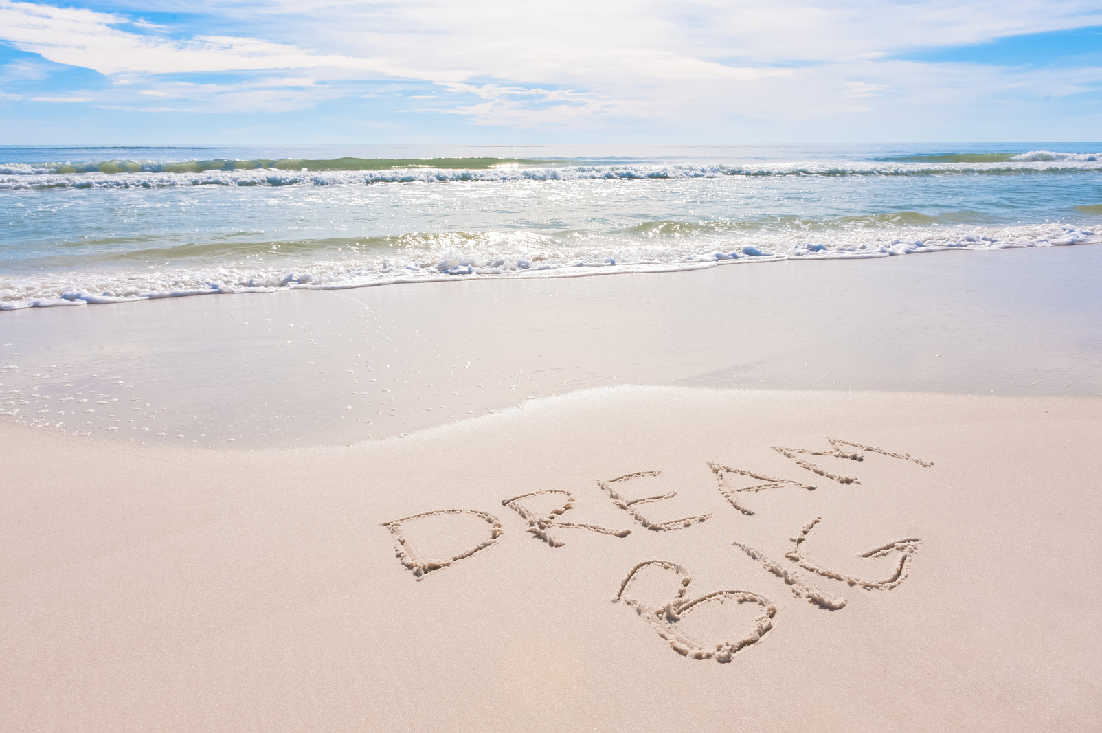
Clarify Your Dream
01
Created To Dream Big
02
Dream Big With God
03
Visualize Your Bright Future
04
Activation Exercises
“For I know the plans I have for you,” declares the Lord, “plans to prosper you and not to harm you, plans to give you hope and a future”. -Jeremiah 29:11
©DREAM BIG ADVENTURE

Slide 5

01.
Created To Dream Big
“When God created you, He created a dream and wrapped a body around it”. -Lou Engle
  We Are Made In God’s Image
  God Has Plans & A Future For Us
  Dreams Increase Our Faith
  Dreams Refine Our Character
  Dreams Are A Vehicle For Blessings
  Our Dreams Inspire Others To Dream
©DREAM BIG ADVENTURE

Slide 6


Created To Dream
©DREAM BIG ADVENTURE

Slide 7

02.
Dream Big With God
“Faith is choosing and believing God’s dream for your life. Nothing starts happening in your life until you start dreaming. God gave you the ability to dream, to create, to image.” - Rick Warren
  Imagine All The Possibilities
  Be Creative & Childlike
  Take The Limits Off
  Release Other’s Expectations
  Find Your Why & Who
  Feel The Excitement
“Dare to live the life you have dreamed for yourself. Go forward and make your dreams come true.”
- Ralph Waldo Emerson
©DREAM BIG ADVENTURE

Slide 8



Dream Big With God
What?
Where?
Encouraging Community
Equipping Content
Empowering Events
Online & In Person Events
My Dream
To create a company and community that empowers women to Achieve Their Dreams & Prosper With God.
Who?
Why?
For Women To Walk Freely In Their Divine Identity, While Increasing Their Kingdom Impact & Income.
Kingdom Women With Big Dreams
& Their Kids.
©DREAM BIG ADVENTURE

Slide 9

03.
Visualize Your Bright Future
“To courageously imagine or dream of a better future for yourself, for your family, or for others is an act of faith. You are saying, “I believe that things can change and can be different, and I believe that God will enable me to accomplish it!” - Rick Warren
  The Power Of Vision
  Thoughts Become Things
  Believe You Can & You Will
  Words Matter, Speak Life
  Stay Focused & Prioritize
  Decrees & Affirmations
©DREAM BIG ADVENTURE

Slide 10

Visualize Your Bright Future
Imagine Your Future Day
Visualize The Best That Could Happen
Define Achieving Your Dream
Determine The Timing Of Your Dreams
Create A Dream Vision Board
©DREAM BIG ADVENTURE

Slide 11

Clarify Your Dream - Book List
  The Path - Laurie Beth Jones
  Created To Dream - Rick Warren
  Dream Wild - Jennifer LeClaire
  I Dream Big - Havilah Cunnington
  Holy Play - Kirk Byron
©DREAM BIG ADVENTURE

Slide 12
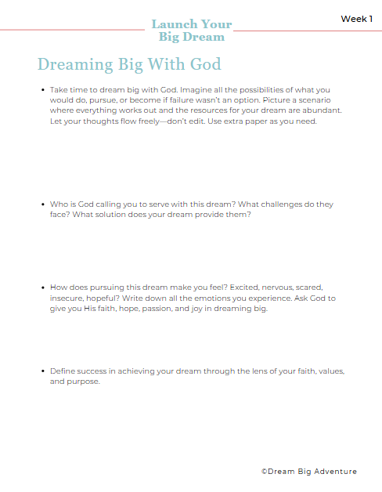
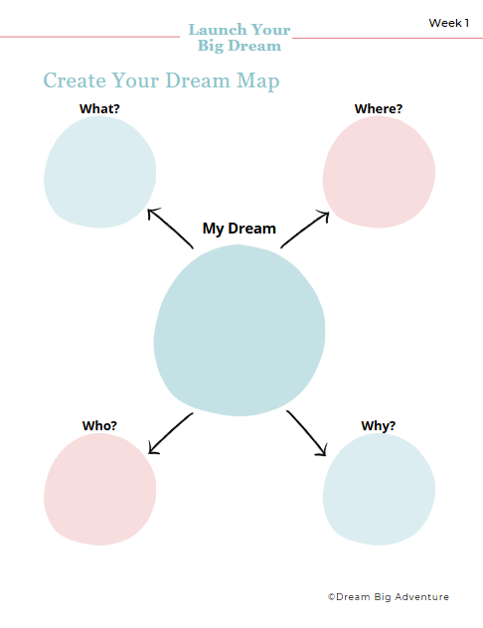
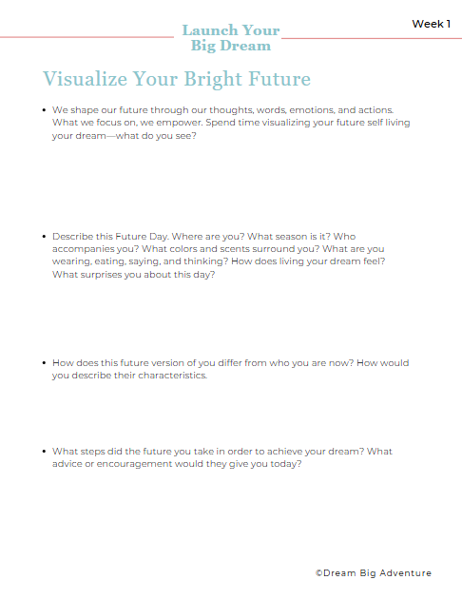
Clarify Your Dream - Exercises
©DREAM BIG ADVENTURE

