Slide 1
Launch Your Big Dream
Week 3
Choose Your Path
COURSE BY JENNIFER MILLER

Slide 2

Choose Your Path
01
Map Your Route
02
Set SMART Goals
03
Create Mini Steps
04
Activation Exercises
“Trust in the Lord with all your heart and lean not on your own understanding; in all your ways acknowledge Him, and he will direct your path."
Proverbs 3:5-6
©DREAM BIG ADVENTURE

Slide 3

01.
Map Your Route
“A "dream" is a guiding beacon, pulling you towards what you want, while a "goal" is the actionable path you take to reach that dream; essentially, a dream is the big picture vision, and a goal is the concrete steps to achieve it, requiring action to turn the dream into reality”. - Mel Robbins
  Find Your Starting Point
  Define Your Finish Line
  Set Your Divine GPS
  Confirm Your Speed
  Mark Your Milestones
  Set SMART Goals
  Create Mini Steps
©DREAM BIG ADVENTURE

Slide 4




Map Your Route
Create A Kids Version of DBA Challenge
Publish Dream Big Adventure Book and Guide
Finish Line
Launch Dream Big Adventure Website
Launch Dream Big Adventure Podcast
To create a company and community that empowers women to achieve their dreams and prosper with God.
Launch Dream Big Adventure Challenge
Host A Dream Big Adventure Trip
Launch Dream Big 4 Week Course
Launch New Social Media Platform
Starting Place
I am a Beloved Daughter of God and more than enough to achieve this Big Dream!
©DREAM BIG ADVENTURE

Slide 5

02.
Set SMART Goals
“Setting goals is the first step in turning the invisible into the visible." - Tony Robbins
  S - Specific
  M - Measurable
  A - Achievable
  R - Relevant
  T - Time-Bound
“Extraordinary results are directly determined by how narrow you can make your focus … when you spread yourself out, you end up spread thin.” - Gary Keller
©DREAM BIG ADVENTURE

Slide 6






Set SMART Goals
What dream goal does God want me to achieve first?
How will I know when I have reached this goal?
Is this goal achievable with God’s help?
Why is this goal important?
What is the timeline for this goal?
©DREAM BIG ADVENTURE

Slide 7

03.
Create Mini Steps
“What if the biggest thing keeping us from doing what matters is the false assumption that it has to take tremendous effort? What if, instead, we considered the possibility that the reason something feels hard is that we haven’t yet found the easier way to do it?” - Greg McKeown
  Define What Done Looks Like - Finish Line
  Start With The First Thing - Domino
  Simplify The Process - Ugly Baby
  Slow & Steady Pace - Set Min & Max
  Progress Not Perfection - Stop Tinkering
  Clear & Easy Steps - 10 Minutes
©DREAM BIG ADVENTURE

Slide 8

Map It, Milestone It, Mini Step It
Milestone - Launch New Social Media Platform for DBA
Goal - Launch Social Media March 10th and post once daily.
  Dream
    Milestones
      SMART Goals
        Simple Mini Steps
Simple Mini Steps
  Finalize The Branding for DBA
    Confirm Look & Feel
    Select Colors, Font, Icons
    Design Logo Variations
    Export Logo
    Create Templates for Social Media
  Create A Social Media Content Plan
  Set Up New Social Media Accounts
  Create 2 Weeks Of Reel & Post Scripts
  Record 14 Videos
  Edit The Videos
  Schedule Posts
  Comment & Engage
  Evaluate & Refine
©DREAM BIG ADVENTURE

Slide 9

Choose Your Path - Book List
  Effortless - Greg McKeown
  The One Thing - Gary Keller
  Atomic Habits - James Clear
  Goals - Zig Ziglar
  The 5 Second Rule - Mel Robbins
©DREAM BIG ADVENTURE

Slide 10
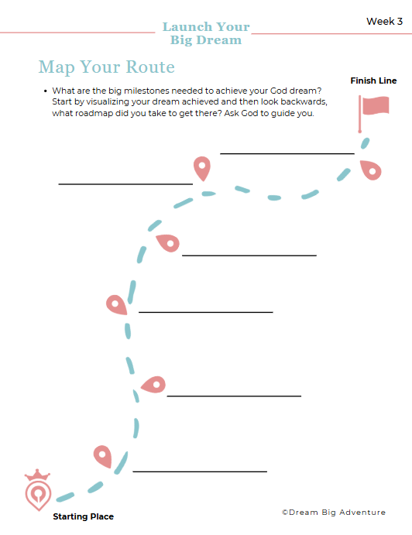
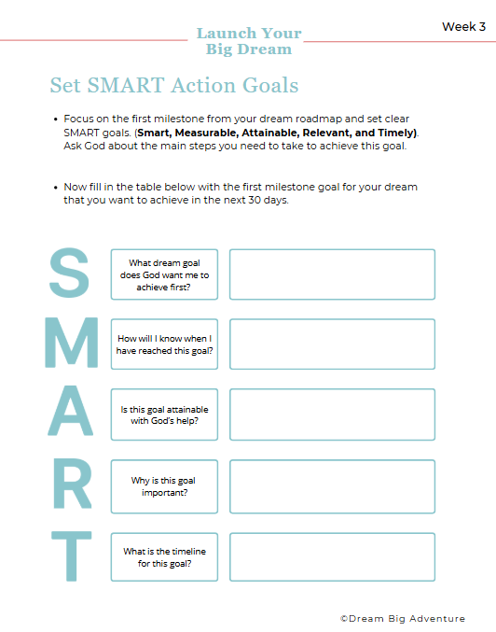
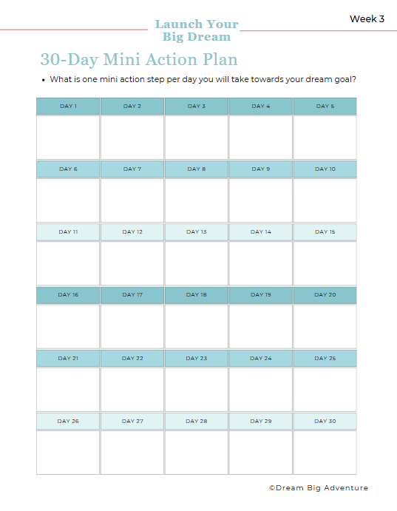
Choose Your Path - Exercises
©DREAM BIG ADVENTURE

