Slide 1
Launch Your Big Dream
Week 4
Courageously Take Action
COURSE BY JENNIFER MILLER

Slide 2

Courageously Take Action
01
Dream Big - Start Small
02
Break Through Resistance
03
Co-Create With God
04
Embrace An Adventure Mindset
05
Activation Exercises
“Have I not commanded you? Be strong and of good courage; do not be afraid, nor be dismayed, for the Lord your God is with you wherever you go.” Joshua 1:9
©DREAM BIG ADVENTURE

Slide 3
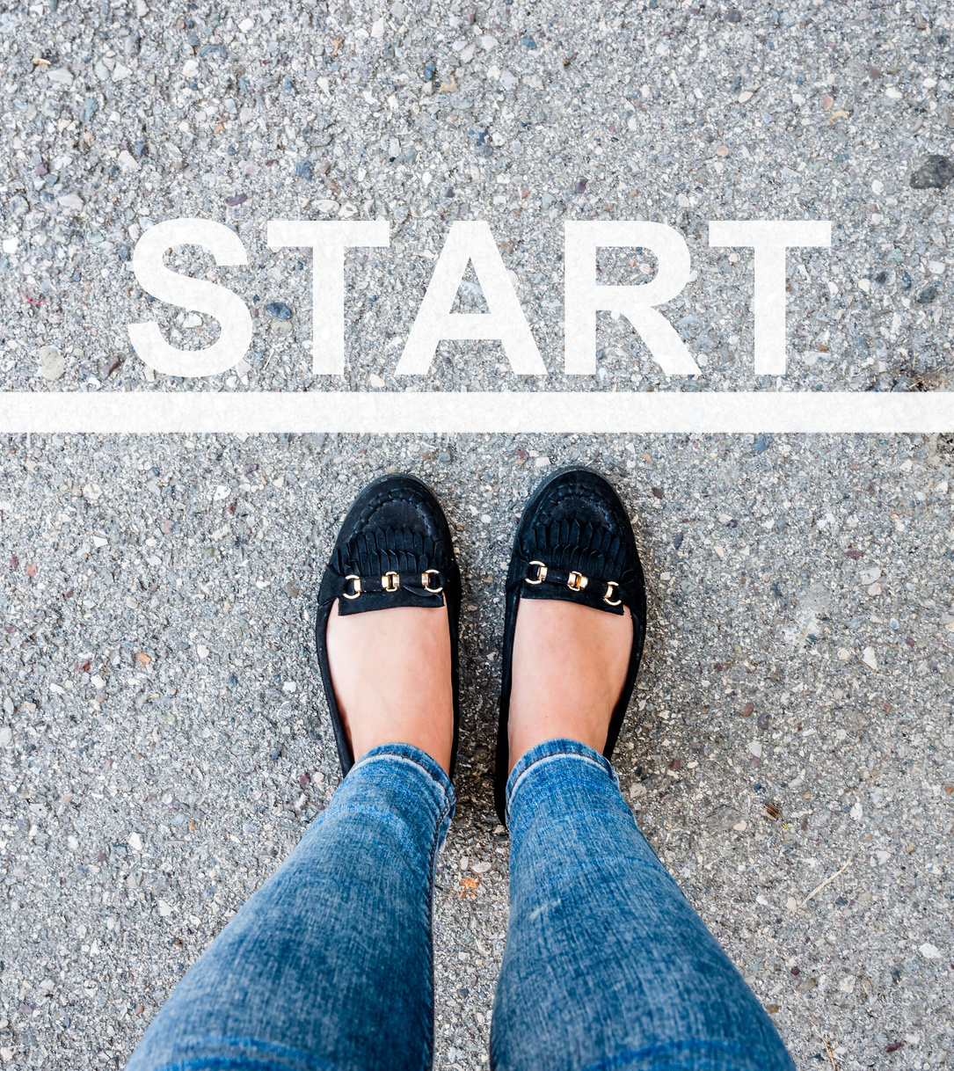
01.
Dream Big - Start Small
“Never doubt God's mighty power to work in you. He will achieve infinitely more than your greatest request, your most unbelievable dream, and exceed your wildest imagination! He will outdo them all, for his miraculous power constantly energizes you”. - Ephesians 3:20 TPT
  Start Small
  What’s In Your Hand?
  Multiplication
  God’s Math
  Just Start
  Be Courageous
Courage – is the willingness to act in obedience to God’s call and purpose, replying on His strength and guidance.
©DREAM BIG ADVENTURE

Slide 4



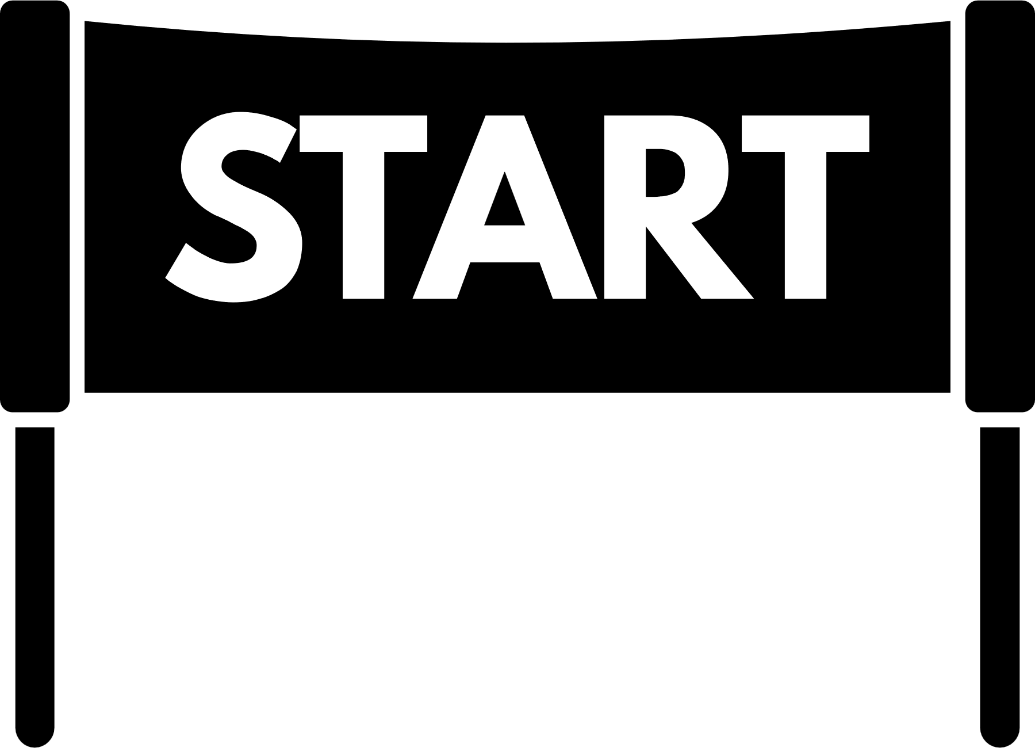
Dream Big - Start Small
Your Small Step
God’s Power
Miraculous Results
©DREAM BIG ADVENTURE

Slide 5

02.
Break Through Resistance
“Resistance is directly proportional to love. If you’re feeling massive Resistance, the good news is, it means there’s tremendous love there too. If you didn’t love the project that is terrifying you, you wouldn’t feel anything”.
- Steven Pressfield
  Fear Of _________
  Procrastination
  Confusion
  Chaos
  Hesitation
Resistance Is The Wall Of Fear That Stands Between You And Your Dream.
©DREAM BIG ADVENTURE

Slide 6




Keys To Breakthrough
Jericho was a symbol of resistance against God's promises and their inheritance.
  Look Up & Worship
  Pray, Listen & Obey
  Take Courageous Action
  Believe For Breakthrough
  Receive Your Blessings
Perfect Love Casts Out Fear!
“God places the best things in life on the other side of fear.” - Will Smith
©DREAM BIG ADVENTURE

Slide 7

03.
Co-Create With God
We must create through the Holy Spirit and bring the Kingdom to our lives, families, church, and world.
- Dr. Nick Castellano
  Connect To The Creator
  Choose Positivity
  Flow Not Force
  Have Fun
  Co-Create Your Day
  Creative Flow Cycle
©DREAM BIG ADVENTURE

Slide 8

Creative Flow Cycle
Reach
Rise
Release
Resistance
Rest
Rest
Receive
Receive
  Rest - Rest is where you will receive new ideas, clarity, direction, energy, and wisdom.
  Rise - Break through resistance by taking courageous action and trusting God.
  Reach - Keep making progress until you reach the dream goal God has given you.
  Release - Then release the outcome, timing, provision, and results to God.
©DREAM BIG ADVENTURE

Slide 9

04.
Embrace An Adventure Mindset
  Be courageous, open to possibilities, and explore.
  See both the ups and downs as part of the journey.
  Find the hidden gems in the difficulties.
  Follow your guide and trust the process to God.
  Embrace the unexpected and go with the flow.
  Life doesn’t have to be perfect to be wonderful.
  Take time to refuel, rest, and have fun.
  Remember the journey is better with friends!
©DREAM BIG ADVENTURE

Slide 10














Dream Big Adventure
11. Enjoy Your Journey
A Girl’s Trip Guide To Believe The Impossible, Break Through Resistance & Birth Big Dreams
12. Celebrate Your Wins
7. Start Your Adventure
5. Invite Your Friends
9. Follow Your Guide
10. Refill Your Tank
3. Map Your Path
6. Set Your Compass
1. Your Starting Place
8. Watch Your Roadblocks
2. Plan Your Trip
4. Pack Your Bags
©DREAM BIG ADVENTURE

Slide 11

Courageously Take Action - Book List
  The Jericho Fast - Rhonda Faye Diehl
  The Joshua Generation - Brian Simmons
  Breakthrough - Shawn Bolz
  The War On Art - Steven Pressfield
  Effortless - Greg McKeown
  Awaken The Sleeper - Dr. Nick Castellano
©DREAM BIG ADVENTURE

Slide 12
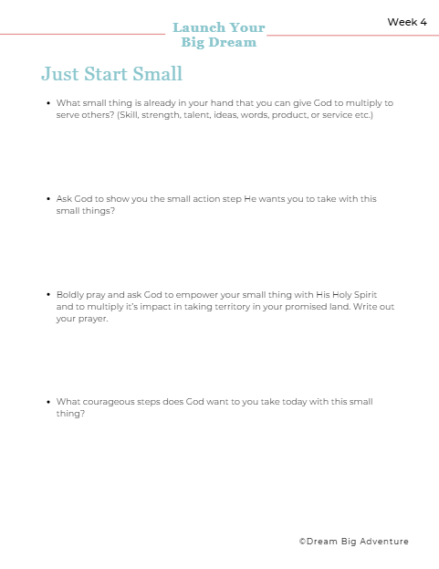
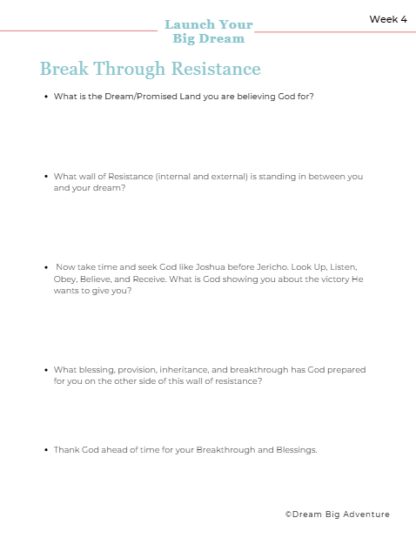
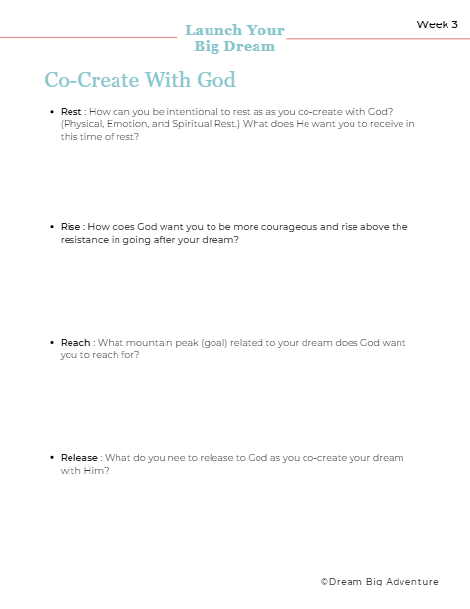
Courageously Take Action - Exercises
©DREAM BIG ADVENTURE

