Slide 1
THE HUB:

Slide 2
JESUS SAID:
I AM THE WAY AND THE TRUTH AND THE LIFE
I HAVE COME THAT YOU SHOULD HAVE LIFE AND HAVE IT MORE ABUNDANTLY

Slide 3
NOW
CULTURE OF DISCONNECTION:
  From the Creation out of which were created
  From each other: our tribe
  From our own self awareness
CULTURE OF DISEASE
CULTURE OF FEAR
  Believing bad will happen
CULTURE OF DEATH
Notes:
3

Slide 4
HOW DID THIS HAPPEN
Progressive , little steps
Progressive disconnect
In the name of 'Progress'
Notes:
4

Slide 5
EDEN
WE STARTED IN EDEN;
1.GARDEN
2. IN PERFECT RELATIONSHIP WITH THE CREATOR
3. CLOTHED IN HIS GLORY
4. IN CONSTANT CONNECTION WITH CREATION
5. FULLY SUPPLIED BY CREATION
6.LIFE OF PURPOSE: TO HUSBAND AND BRING OUT THE BEST IN THE CREATION
7. IN PERFECT RELATIONSHIP WITH OUR GOD-GIVEN PARTNER
8. FOODS ORGANIC, VEGETARIAN

Slide 6
PARADISE LOST
Man chose:
Against God's perfect ways
Decided to work from our own knowledge and ability ( ate from the Tree of Knowledge of Good and Evil)
And we lost our place in the Garden

Slide 7
Age
Hunter/Gatherer
When
; rules
Prehistory
Where Live
Nomadic
Social Structure
Tribal
Ethos
Tribal focus: long term, time; elders revered; societal structure foremost; rules
Lifestyle
Outside, physical activity; primitive, temporary shelter; continual connection environment
Childcare
Infants carried, breastfed, eat adults foods premasticated by mother; raised within tribe; as come of age, inducted into ways of adults
Day/Night
Sleep wake cycles according to natural daylight; firelight, candle light
Seasons
Activities, foods seasonal: 'hibernation'
Clothing
Simple clothing, all natural materials; connected to earth (barefoot or leather-soled)
Pollution
No toxins except naturally released eg volcanos, bushfires
Electromagnetic Environment
No electromagnetic radiation other than occasional solar flares: connected to earth (giant magnet)
Diet
Game meats, roots, nuts, seeds, berries, leaves (organic, freshly harvested when ripe)
Communication
Face to face communication: hand to hand combat; signals
Diseases/Lifespan
Starvation, acute severe infection, trauma, childbirth: survivors lived to long age
Notes:
7

Slide 8
Age
Herder
When
Early recorded history
Where Live
Nomadic
Social Structure
Tribal
Ethos
Tribal focus; elders revered; societal structure, rules
Lifestyle
Outside, physical activity; primitive, temporary shelters
Childcare
Infants carried, breastfed, raised within tribe; as come of age, inducted into ways of adults
Day/Night
Natural lighting: sleep wake cycles according to natural daylight
Seasons
Activities, foods seasonal: 'hibernation'
Clothing
Minimal clothing, all natural materials; connected to the earth
Pollution
No toxins except naturally released eg volcanos, bushfires
Electromagnetic environment
No electromagnetic radiation other than occasional solar flares: connected to earth (giant magnet)
Diet
Domesticated meats, (sheep, goats), milk (A2), fermented dairy products (in sheep/stomach – natural rennin)
Communication
Face to face communication: hand to hand combat; letters
Diseases/Lifespan
Starvation, acute severe infection, trauma, childbirth
Notes:
8

Slide 9
Age
Agricultural Revolution
When
c. 5,000 BC
Where Live
Villages/cities
Social Structure
Village communities
Ethos
Community focus; elders revered
Lifestyle
Predominantly outside, except very rich; fixed abodes (hut)
Childcare
Increasing division into various trades: boys raised in trades of fathers
Day/Night
Sleep wake cycles according to natural daylight; firelight, candles
Seasons
Activities, foods seasonal: 'hibernation'
Clothing
Minimal clothing, all natural materials; connected to the earth
Pollution
Clearing forests, land degradation; poor sanitation in cities
Electromagnetic Environment
No electromagnetic radiation other than occasional solar flares: connected to earth (giant magnet)
Diet
Introduction of grains, sourdough leavens; fermented foods; organic, unrefined (except very rich)
Communication
Face to face communication: hand to hand combat; letters
Diseases/Lifespan
Starvation, acute severe infection, trauma, childbirth; plagues (cities)
Notes:
9

Slide 10
Age
Industrial Revolution
When
Mid-1800s
Where Live
Cities
Social Structure
Extended families
Ethos
Family focus; elders revered
Lifestyle
Factories: inside
Childcare
Increasing separation of families, infants cared for by others, children schooled outside of home, fathers working apart from family
Day/Night
Increasing work in poor light, lack of sunlight
Seasons
Work increasingly unrelated to seasons
Clothing
Heavier clothing as protection, still natural fibres
Environmental Pollution
Large scale industrial pollution (coal); sanitation wastes cities
Electromagnetic Environment
Still mostly environmental electromagnetism
Diet
Introduction refined foods, sugars more widespread
Communication
Face to face communication: hand to hand combat; letters
Diseases/Lifespan
Increasing disease (pollution, poor food, sanitation, sunlight, overcrowding)
Notes:
10

Slide 11
Age
Electrical Revolution
When
1900s
Where Live
Cities
Social Structure
Extended families
Ethos
Family; elders revered
Lifestyle
Increasingly indoors; working increasingly into nights; homes with electricity
Childcare
Continued separation families, children
Day/Night
Increasing hours in artificial lighting, working into nights
Seasons
Work not related to seasons
Clothing
No further change
Pollution
Increasing pollution (coal-fired power plants)
Electromagnetic Environment
Abnormal electromagnetic radiation from electrical machinery
Diet
Refrigeration; increasing use of refined foods, sugars; less fermentation foods
Communication
Telegraph; telephone; increased distance conversation and brevity of conversation
Diseases/Lifespan
Reduction infectious diseases (improved sanitation); improved lifespan
Notes:
11

Slide 12
Age
Chemical Revolution
When
WWII
Where Live
Cities
Social Structure
Extended families
Ethos
Family focus; elders revered
Lifestyle
Factories, offices - more indoors. Chemicals in home and work environments
Childcare
Continued separation families, children
Day/Night
Increasing hours in artificial lighting, working into nights
Seasons
Work not related to seasons
Clothing
Introduction of synthetic materials
Environmental Pollution
Chemical fertilisers, pesticides, herbicides: large scale land and water pollution; antibiotics in feed; plasticisers
Electromagnetic Environment
Abnormal electromagnetic radiation from electrical machinery
Diet
Increasing use of refined foods, sugars; introduction of food additives; packaged foods; still often backyard gardens, chooks
Communication
No further change
Diseases/Lifespan
Improved recovery infections (antibiotics); further reductions infectious disease (sanitation, specific vaccination), improved lifespan
Notes:
12

Slide 13
Age
Technological Revolution
When
1970s +
Where Live
Cities
Social Structure
Nuclear families
Ethos
(Nuclear) family focus; elders now longer revered but separated, burden
Lifestyle
Predominantly indoors, little physical activity; more women in workforce, increasing speed
Childcare
Infants separate from mothers, prolonged breastfeeding rare, external childcare routine, loss of generational trade skills
Day/Night
Increasing office work, artificial environments, disruption of natural sleep-wake cycles
Seasons
Work almost completely unrelated to natural seasons
Clothing
Synthetic clothing, rubber soled shoes, synthetic floor covering and housing materials, people often disconnected from earth 24/7
Pollution
Additional chemicals in homes, offices
EMR
Increasing EMR pollution as increasing use electrical goods in homes, work
Diet
Supermarket diet – little/no contact with food sources, food increasingly refined, processed, packaged; ‘fast foods’
Communication
Increasing use of distance communication
Diseases/Lifespan
Reduction previous ‘childhood infections’ (?vaccination), Increasing autoimmune, degenerative diseases, new infections, childhood neurodevelopmental disorders
Notes:
13

Slide 14
Age
Communication Revolution
When
1990s+
Where Live
Cities
Social Structure
Single parent families/lone
Ethos
Self focus: fast, immediate; youth, beauty revered
Lifestyle
Indoors, often no significant physical activity
Childcare
Infants routinely separated, bottle fed, cared for outside home in childcare centres; children schooled outside of home; young people change jobs every 2 to 3 years
Day/Night
Little dependence on natural day-night cycles
Seasons
No change in work according to seasons
Clothing
Synthetic
Environmental Pollution
Widespread chemical pollution
Electromagnetic Environment
Widespread pollution with microwaves (mobile phones), increasing use of wireless technology
Diet
Predominantly shop bought, processed, packaged, prepared foods, take aways; no connection with source of food
Communication
Communication via computer, mobile phones: messages brief, superficial
Diseases/Lifespan
Increased behavioural, psychological, neurodevelopmental abnormalities, cancers, obesity, ‘new diseases’ etc; shortening lifespan
Notes:
14

Slide 15
Disconnection, Dysconnections: the ‘I Generation’
LOSS OF CONNECTION TO THE PLANET:
  in our lifestyle, clothing, food
LOSS OF DEEP CONNECTION WITH EACH OTHER:
  Replaced by artificial environments, light, air, foods, materials,
REPLACED FACE TO FACE FULL CONVERSATIONS AND RELATIONSHIPS WITH INCREASINGLY BRIEF MESSAGING VIA COMPUTER/PHONES
  ‘i’pads, ‘i’phones, ‘i’pods, artificial relationships on facebook
FOCUS: IMMEDIATE, ‘I’
Notes:
15

Slide 16
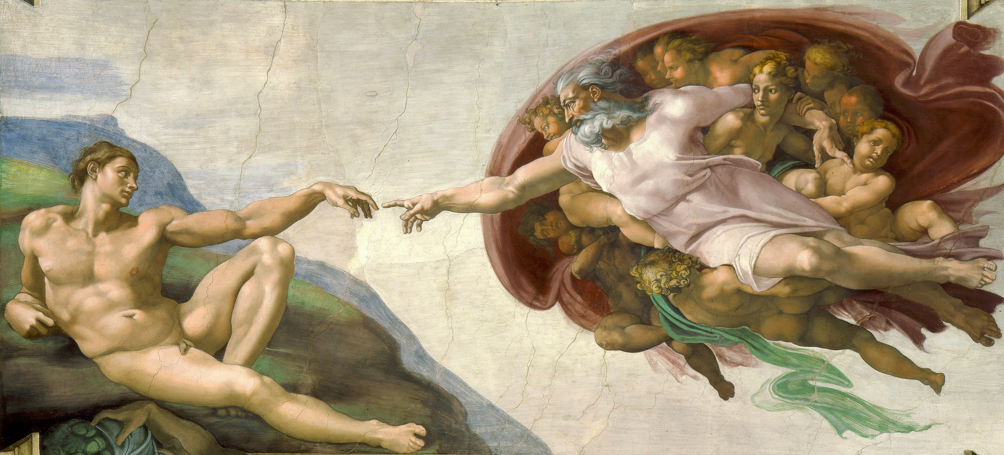
NEED FOR
RECONNECTION
RESTORATION
Notes:
16

Slide 17
GOD
FATHER
SON
HOLY SPIRIT
Notes:
17

Slide 18
MAN
'Made in our image'
BODY
SOUL
SPIRIT
Notes:
18

Slide 19
BODY SOUL SPIRIT
Notes:
19

Slide 20
NEUROPEPTIDES BIOENERGETICS
BODY
SOUL
SPIRIT
Notes:
20

Slide 21
BIOENERGETICS
Electrical
Frequencies vibration: Schumann frequency
Brain
Heart
Synchronicity
Quantum
Energy: spirit interface
Psychoactive medications
Notes:
21

Slide 22
SPIRIT
Spirit – Life force
God – breathed
Into our nostrils
Carried on breath
Notes:
22

Slide 23
BODY SOUL SPIRIT
Notes:
23

Slide 24
BODY
Temple where God / Jesus / Holy Spirit resides
Clothing/tent
Notes:
24

Slide 25
BODY
Microcosm of earth: 2/3 covered in salt water
Bag of water: 2/3 salt water
Suspended minerals
Operated on by natural 'chemicals
Notes:
25

Slide 26
TEMPLE
Architects plan: DNA
Quality materials: foods
Site foreman: brain, nervous system
Messengers: hormones, cytokines, phytochemicals
Labourers: enzymes
Maintenance
Notes:
26

Slide 27
SOUL
FEELINGS THOUGHTS WILL
Emotions Mind Choice
Notes:
27

Slide 28
NEUROPEPTIDES
BODY
Feelings ( physical sensations)
SOUL
Feelings
( emotions)
2 - way street
Notes:
28

Slide 29
AUTONOMIC NERVOUS SYSTEM
1. SYMPATHETIC: SNS:
  Alarm System
  Primitive, reactive
  Flight/Fright/ Fight response
2. PARASYMPATHETIC: PNS
  Mature responses
  Rest, Digest, Repair
Notes:
29

Slide 30
FEELINGS
Initially automatic responses
SYMPATHETIC NERVOUS SYSTEM (body)
Feelings:
fear, anger, sadness (withdrawal)
Notes:
30

Slide 31
SOUL
FEELINGS THOUGHTS WILL
Emotion Mind Choice
Notes:
31

Slide 32
SOUL
FEELINGS
Fear
Anger
Sadness
THOUGHTS
I am afraid
I am angry
I am sad
Notes:
32

Slide 33
NEUROPEPTIDES BIOENERGETICS
BODY SOUL SPIRIT
Feelings Thoughts Will
Fear I am afraid Ability
Anger I am angry to
Sadness I am sad choose

Slide 34
WILL
Ability to choose
CHOOSE LIFE
Moses
Deut 32
Notes:
34

Slide 35
LIFE THOUGHTS
Mind of Christ
Take every thought captive
EFear
AAnger
SSadness
Faith/Love
Peace
Joy
First 3 fruits of Spirit
Notes:
35

Slide 36
BODY SOUL SPIRIT
NEUROPEPTIDES BIOENERGETICS
Temple
Feelings Thoughts Will
Life
Fear
Anger Sadness
Fear I am afraid Ability
Anger I am angry to
Sadness I am sad Choose
Faith/love
Peace
Joy
SNS
PNS
Notes:
36

Slide 37

WHEEL OF LIFE
Notes:
37

Slide 38
CREATION STORY
Genesis: ( beginning)
Day 1:
'the earth was unformed and void, darkness was on the face of the deep, and the Spirit of God hovered over the surface of the waters’
DIVINE CREATION ENERGY
Notes:
38

Slide 39
CORE:
AXLE OF WHEEL OF LIFE
LOVE
PEACE
JOY
Notes:
39

Slide 40
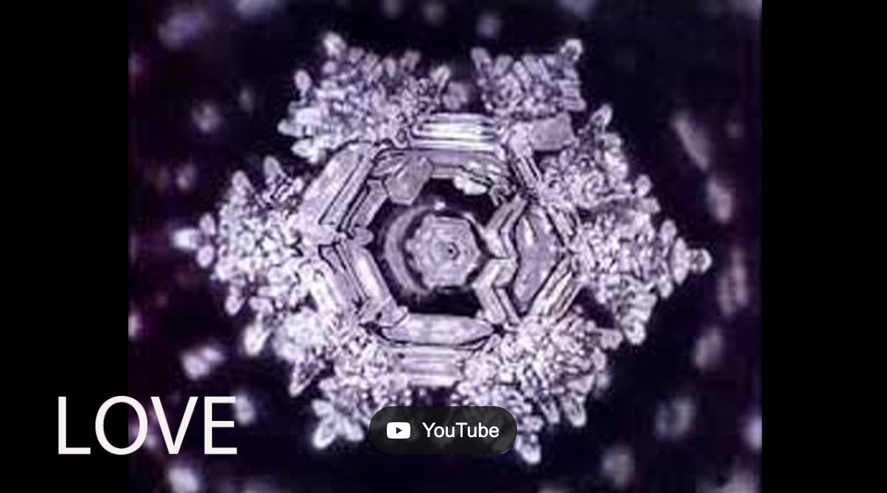
LOVE VIBRATION:
Notes:
40

Slide 41

Notes:
41

Slide 42
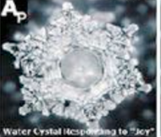
JOY
Notes:
42

Slide 43
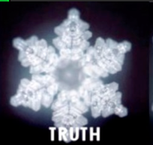
Notes:
43

Slide 44
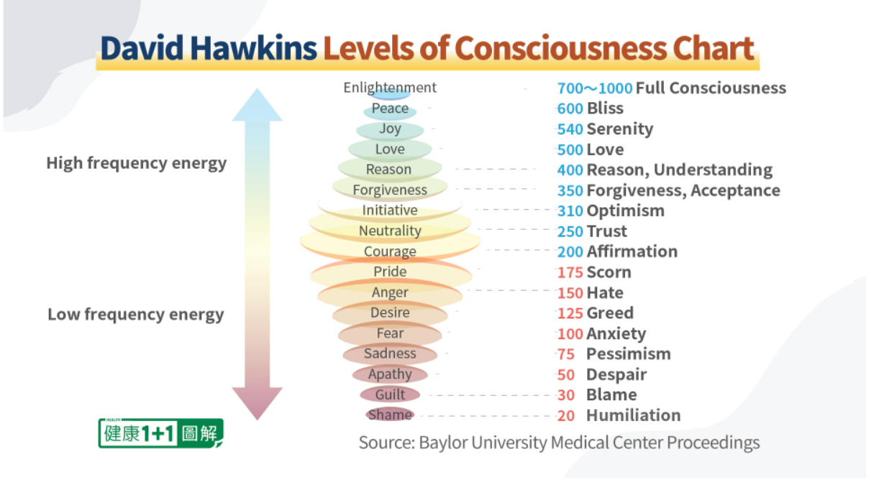
Notes:
44

Slide 45
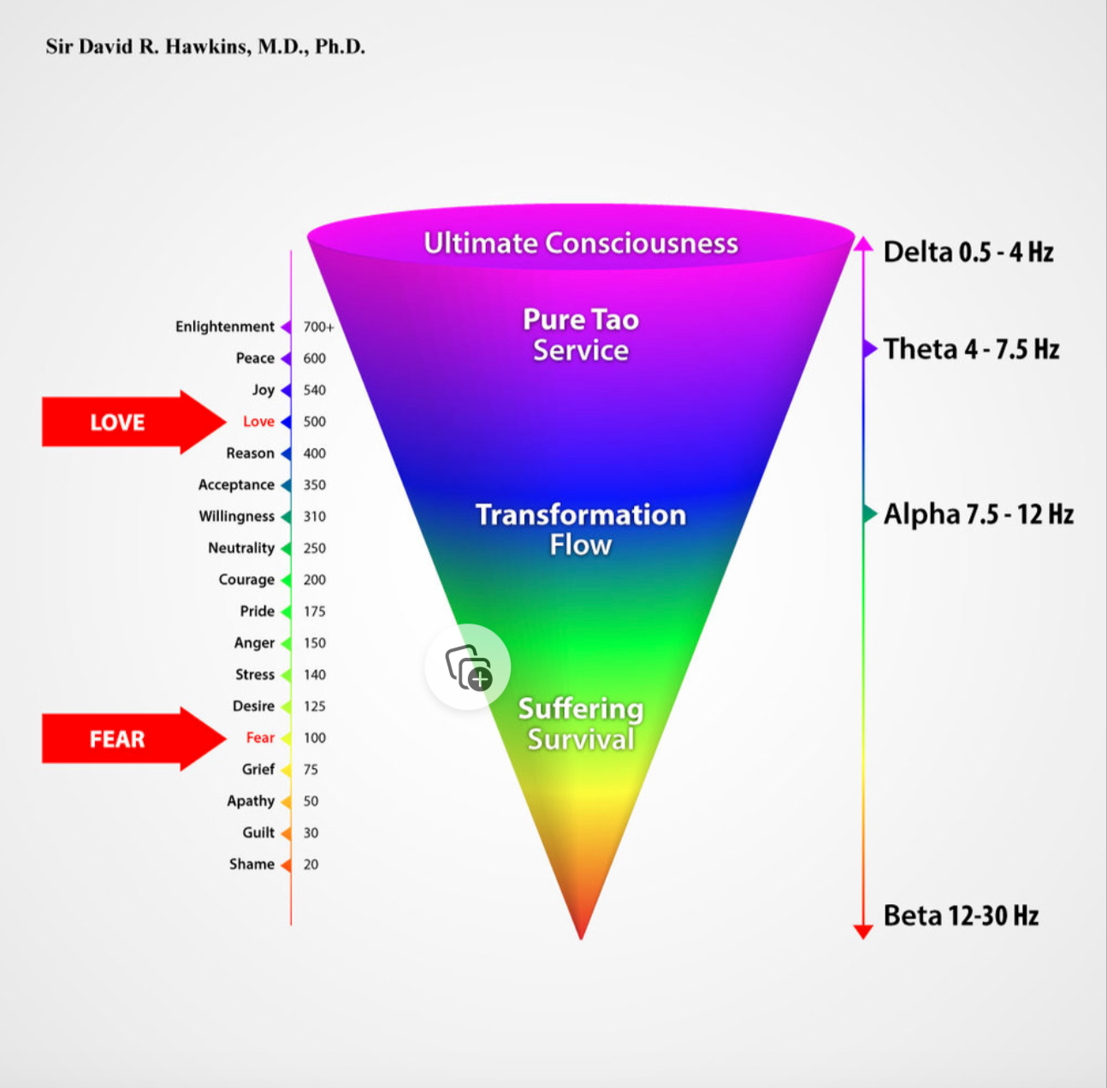

Slide 46
THE WHEEL OF LIFE
LIVING IN THE FULLNESS:
ABUNDANT LIFE AND HEALTH
THAT JESUS CAME FOR US TO HAVE
FULLY REALISING THE POTENTIAL OF OUR DNA
GODS BLUEPRINT FOR US
IMMORTAL, LIGHT-BEINGS

Slide 47
PROF ROBYN COSFORD
MBBS(HONS) FACNEM FASLM
DIP NUTR
www.revayalife.com

